Slide 1

Diabetic Ketoacidosis

Slide 2


Findings
70-year-old
Transported via ambulance
Found unconscious
Strong fruity odor to breath
Intubated and has IV access
DNR order present and accompanied by his presumed signature
Notes:
A 70-year-old male is brought to the Emergency Department (ED) by an ambulance. He was found unconscious and has a strong, fruity odor to his breath. He is intubated and has IV access. He has DO NOT RESUSCITATE accompanied by his presumed signature tattooed to his anterior chest.

Slide 3

Patient Medical History
  Diabetes
  Asthma/COPD
  Respiratory rate 24 bpm audible wheezing
  Cardiovascular S1S2
  Skin no visible wounds, tattoo present on
  anterior chest, no edema present skin diaphoretic
  Genitourinary strong urine odor
  Gastrointestinal bowel sounds present x 4 quadrants
  EENT PERRLA, fruity breath odor, oral mucosa pink and moist
  poor dentition
Notes:
Based on the information provided, the patient has a history of diabetes, asthma, and COPD. The patient’s physical assessment reveals a respiratory rate 24 breaths per minute with audible wheezing and heart sounds S1 & S2 noted with a capillary refill of <3, and no edema noted. There are no visible wounds noted to skin, skin is diaphoretic, has good turgor. Patient has a visible tattoo to anterior chest with presumed signature. The patient has a strong urine odor, bowel sounds active in all 4 quadrants, PERRLA, fruity breath odor, oral mucosa pink and moist, poor dentition.
Diabetes is evident in the fact that the patient has been prescribed Novolog insulin, as well as that of NPH insulin.
Asthma and/or COPD are evident in the fact that the patient has been prescribed a Proventil inhaler.

Slide 4
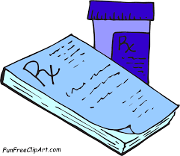
Patient Medications
The following medications have been prescribed to the patient:
  Novolog insulin, 5 units SQ before meals
  NPH insulin, 40 units SQ at 7am and 5pm
  Aspirin, 325 mg PO Q day
  Theo-dur ER, 300mg PO Q day
  Proventil inhaler, as needed
  Rivaroxaban (Xarelto), 20 mg PO Q day
Notes:
The patient was prescribed Novolog insulin. The patient will take 5 units subcutaneously prior to meals.
The patient has also been prescribed 40 units of NPH insulin to be administered subcutaneously at both 7am and 5pm.
The patient should also take 325 mg of Aspirin by mouth q day.
Theo-dur – extended release - has been prescribed for the patient as well. The patient has been prescribed 300 mg per day.
The patient also has a Proventil inhaler to be taken as needed as well as a prescription for 20 mg of Rivaroxaban daily.
Xarelto works with Aspirin to prevent blood clots. The blood clots may cause heart attacks or even strokes.

Slide 5
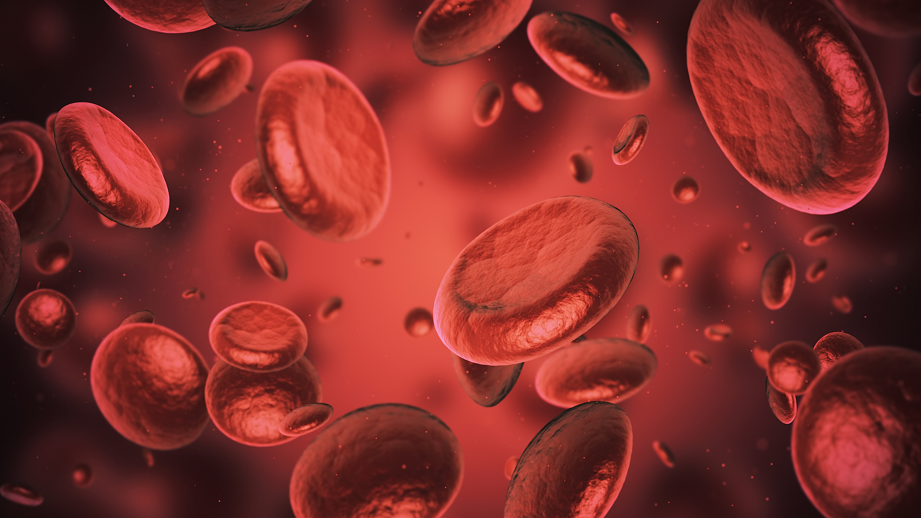
Etiology and Pathophysiology of Diabetic Ketoacidosis
  Diabetic ketoacidosis is a hyperglycemic emergency related to diabetes
  DKA usually occurs in patients with Type 1, or insulin dependent, diabetics
  DKA can occur if insulin type or dosing is changed, growth spurt in an adolescent, as well as surgery, infection and trauma
  Results of certain diagnostic tests determines whether the patient is experiencing DKA, it is not determined by blood glucose levels only
  Pathophysiology:
    Insulin deficiency
    Hyperglycemia
    Fluid volume deficit
    Ketoacidosis
    Acid-base balance
    Gluconeogenesis
    Note: Adapted from "Priorities in Critical Care Nursing," Urden, et al., 2020 pp405-407)
Notes:
Urden, et al. (2020) states that diabetic ketoacidosis, or DKA, is a life-threatening complication of diabetes and is categorized as mild, moderate or severe. There is a misconception that DKA is due to insulin non-compliance, but that is not always the case. Urden, et al., cites the following criteria for the diagnosis of DKA: blood glucose greater than 250 mg/dL, pH less than 7.3, serum bicarbonate less than 18 mEq/L and moderate or severe ketonemia or ketonuria.

Slide 6
Clinical Manifestations/Diagnostic Tests
Dry mouth, polydipsia, polyuria, polyphagia, dehydration, dry skin, hypotension, weakness, ketoacidosis, air hunger, acetone breath odor, deep and rapid respirations, nausea, vomiting (Urden, et al., 2020)
Hourly monitoring of blood glucose, potassium and arterial blood gas
Abnormal Lab Data Rationale
  Insulin deficiency-the pancreas does not produce enough insulin in a patient with Type 1 diabetes
  Hyperglycemia-the blood becomes hyperosmolar, increase the blood glucose
  Fluid volume deficit-excessive urination with sugar being found in the urine occurs, dehydration and electrolyte imbalance, especially potassium
  Ketoacidosis-ketones are found in the blood and urine
  Acid-base balance-pH and bicarbonate drop
  Gluconeogenesis-process of breaking down fat or protein to make glucose
  Note: Adapted from "Priorities in Critical Care Nursing", Urden, et al. 2020
Notes:
Without insulin to move glucose from the bloodstream into the cell to be used or stored, it stays in the bloodstream, causing the blood glucose to rise. When the blood becomes hyperosmolar, cellular dehydration occurs because the body is pulling fluids into the vascular space to try to restore normal osmolality. (Urden, et al.) Ketones are not normally found in the blood or urine. Acid ketones disassociating result in hydrogen ions, with makes the pH drop. When the pH and bicarbonate drop, that is when the patient may exhibit the classic sign of DKA, the fruity smell noted in their breath. The deep and rapid breathing pattern is known as Kussmaul respirations. When protein is used for gluconeogenesis, it leaves no reserve to repair the vital body tissues. (Urden, et al.)

Slide 7
Clinical Practice Guidelines
"The goals of treatment are to reverse dehydration, replace insulin, reverse ketoacidosis, and replenish electrolytes." (Urden, et al., 2020)
  Medical Guidelines
    Aggressive IV fluid replacement
    Bolus insulin and start insulin drip
    By administering fluids and starting insulin, ketoacidosis will be reversed
    Replenishing electrolytes, especially potassium
  Nursing Management
    Administer prescribed fluids, insulin and electrolytes
    Monitor response to therapy
    Monitor for complications
    Provide patient education
Note: Adapted from "Priorities in Clinical Care Nursing," Urden, et al., 2020
Notes:
According to Urden, et al. (2020), "Aggressive IV fluid replacement is provided to rehydrate the intracellular and extracellular compartments and prevent circulatory collapse....Replacement of fluid volume and administration of insulin are designed to interrupt the ketonic cycle and reverse metabolic acidosis. In the presence of insulin, glucose enters the cells, and the body ceases to convert fat into glucose....The potassium level must e be checked frequently, as insulin drives potassium into the cells and the serum potassium can drop precipitously." (p. 408)

Slide 8
Medical/Collaborative Orders
Orders
Rationale
Novolog insulin: 5 units SQ before meals
NPH insulin: 40 units SQ at 7am and 5pm
Aspirin: 325 mg PO Q day
Theo-dur: 300mg extended-release Q day
Proventil: PRN
Rivaroxaban (Xarelto): 20 mg PO Q day
Mechanical ventilation
IV access
Ultra-short acting insulin (5-15 minutes/30-90 minutes/<5 hours), taken with food and in combination with intermediate-long-acting insulin (Urden et al, 2020, table 23.2), used when patient is awake and clinical lab indicators are stable
Intermediate-acting insulin (2-4 hours/4-10 hours/10-16hours), used in combination with the shorter acting insulin (Urden et al, 2020, table 23.2), used when patient is awake and clinical lab indicators are stable
Antipyretic (fever reduction), antiplatelet agent (clot reduction) incase of possible MI, possible pain relief once conscious (Urden et al, 2020)
“Used to dilate bronchial smooth muscle and reverse diaphragmatic muscle fatigue (Urden et al, 2020 table 15.10),” used in asthma and COPD
Beta 2 agonist, symptomatic management of COPD or asthma (Medline, 2016)
Prevention of thromboembolism (Urden et al, 2020, p. 216), could indicate history or new onset of A-fib
“Indications for mechanical ventilation include cardiac or respiratory arrest, disorientation, failure to respond to bronchodilator therapy, and exhaustion (Urden et al, 2020, p. 254),” patient unconscious, assuming he is not protecting his airway
Aggressive IV fluid replacement in patients with DKA, infusion of regular insulin per hospital protocol, patient is unconscious and intubated so most medications to be given intravenously (Urden et al, 2020, p. 408)
Notes:
While information is limited for our patient, the orders we do have come from the home medication list. The patient has a prescription for Novolog insulin (short acting) and NPH insulin (intermediate acting). We can conclude that the patient is a diabetic based off of this​
Our patient has a prescription for Theophylline (Theo-dur) and Proventil. Based off the purpose of this medication we can conclude our patient has underlying respiratory condition, most likely asthma​
Next, our patient has a prescription for Aspirin and Rivaroxaban (Xarelto). These are commonly prescribed in patients with some sort of underlying cardiac history or stent placement​
Our patient is currently intubated due to being found unresponsive and being unable to protect his airway​
IV access is necessary to administer appropriate IV fluids, sedatives, medications etc. ​

Slide 9
Orders
Anticipated Orders
Rationale
IV isotonic normal saline (0.9% sodium chloride [NaCl])
Initial IV bolus of regular insulin at 0.1 unit for each kilogram of body weight with regular insulin at 0.1 unit/kg/hr infused simultaneously with IV fluid replacement after
Possible potassium chloride replacement
Bicarbonate administration if pH is below 7.0
High concentration of glucose in the vessels draws fluid into the vasculature causing dehydration, IV fluids replenish this volume deficit
Insulin and fluid replacement are designed meant to break the ketonic cycle and reverse metabolic acidosis. Insulin draws glucose into the cell, stopping the conversion of fat into glucose and ketones.
Insulin opens the cell membrane allowing glucose and potassium to enter which reverses metabolic acidosis.
The conversion of fat into glucose also creates acidic ketones which lowers the pH of the blood. Bicarb, a base, can help raise the pH back to acceptable levels.
Notes:
Administration of NS can be anticipated as these patients tend to be dehydrated. Glucose is a large molecule that draws fluid into the vasculature and out of the body form there. Other reasons to administer IVF is to dilute the concentration of glucose in the vasculature
Insulin is anticipated not only to lower blood sugar but also to break the keto cycle of the body converting fat into glucose which creates ketones as a by product
Insulin opens the cell and not only moves glucose into the cell but potassium as well. This can raise pH and reverse metabolic acidosis, but, this mechanism can drop potassium precipitously leading to many complications including cardiac issues, neurological issues, and musculoskeletal problems. Serial monitoring of serum potassium can also be anticipated.
While not as common anymore, bicarb can be administered to raise serum pH but is usually only done if the pH is below 6.9

Slide 10
Nursing Diagnosis
Nursing/Collaborative Diagnosis
Expected Outcomes
Impaired Spontaneous Ventilation
Risk for Ineffective Protection
Risk for Fluid Volume Deficit
Imbalanced Nutrition: Less Than Body Requirements
Patient will remain free of complications from mechanical ventilation
Patient will have a decreased risk for injury from ventilator-associated pneumonia (VAP) through continuous assessment and early interventions
Maintain normovolemic state through monitoring of urinary output greater than 30 ml/hr, elastic skin turgor, capillary refill <2 seconds, normal blood pressure, palpable peripheral pulses, and blood glucose levels between 70-200 mg/dL
Patient will receive appropriate nutrients and demonstrate stabilized weight or weight gain towards desired range with normal laboratory values
Notes:
Impaired Spontaneous Ventilation: risk factors include acute respiratory failure and metabolic factors, in this case, diabetic ketoacidosis
Reference: Martin, P. B. (2019, May 31). 6 Mechanical Ventilation Nursing Care Plans. Nurseslabs. https://nurseslabs.com/6-mechanical-ventilation-nursing-care-plans/
Risk for Ineffective Protection: risk factor for ventilator associated pneumonia include improper settings on the vent and increased secretions
Reference: Martin, P. B. (2019b, May 31). 6 Mechanical Ventilation Nursing Care Plans. Nurseslabs. https://nurseslabs.com/6-mechanical-ventilation-nursing-care-plans/5/
Risk for Fluid Volume Deficit: risk factors for this include hyperglycemia-induced osmotic diuresis and functional inability to drink fluids since the patient was unresponsive and is currently intubated. Nausea, vomiting are also risk factors but due to limited history it is unknown if patient experienced this
Reference: Martin, P. B. (2020, December 5). 4 Diabetic Ketoacidosis and Hyperglycemic Hyperosmolar Nonketotic Syndrome Nursing Care Plans. Nurseslabs. https://nurseslabs.com/diabetic-ketoacidosis-nursing-care-plans/
Imbalanced Nutrition: Less than Body Requirements: patient risk factors consist of patient being unconscious/sedated and unable to consume anything orally; other risk factors include a possible hypermetabolic state from a release of stress hormones and insufficient insulin
Reference: Martin, P. B. (2020b, December 5). 4 Diabetic Ketoacidosis and Hyperglycemic Hyperosmolar Nonketotic Syndrome Nursing Care Plans. Nurseslabs. https://nurseslabs.com/diabetic-ketoacidosis-nursing-care-plans/4/

Slide 11
Nursing Interventions
Impaired Spontaneous Ventilation
Risk for Ineffective Protection
Monitor oxygen saturation using pulse oximetry, which is useful in detecting early changes in oxygen.
Observe for changes in level of consciousness to detect early signs of hypoxia, such as irritability and restlessness.
Assess the skin color, examine the lips and nailbeds for cyanosis. Bluish discoloration shows an excessive concentration of deoxygenated blood and that the breathing pattern is ineffective.
Review the ventilator settings every hour, this guarantees that the patient is receiving correct mode, rate, tidal volume, FiO2, PEEP, to prevent problems.
Assess respiratory rate and rhythm including the work of breathing, this ensures synchrony between the patient and the ventilator and prevents “bucking”.
Assess for signs of pulmonary infection (elevated temperature, purulent secretions, elevated WBCs, (+) cultures, and evidence on CXR). VAPs occur in up to 28% of patients on ventilators.
Notes:
According to Martin (2019), some nursing interventions for DKA include Impaired Spontaneous Ventilation and Risk for Ineffective Protection. With Impaired Spontaneous Ventilation the nurse should monitor the patient’s oxygen saturation, observe for changes in level of consciousness, and assess for bluish discoloration of the skin and nailbeds. For Risk for Ineffective Protection, the nurse should review the ventilator settings every hour, assess respiratory rate and rhythm including the work of breathing, and assess the patient for signs of pulmonary infection.

Slide 12
Nursing Interventions cont…
Risk for Fluid Volume Deficit
Imbalanced Nutrition: Less Than Body Requirements
Assess precipitating factors such as other illnesses, new-onset diabetes, or poor compliance with treatment regimen, to provide baseline data for education once resolved hyperglycemia
Monitor hourly intake and output, due to oliguria and anuria resulting from reduced glomerular filtration and renal blood flow.
Weigh patient daily to obtain a baseline of current fluid status and adequacy of fluid replacement. A weight loss of 2.2lbs over 24 hours indicates a 1L of fluid loss.
Once the patient is extubated, collaborate with the dietitian for initiation of resumption of oral intake, they help in calculating and adjusting diet to meet nutritional needs of the patient.
Recognize the signs of hypoglycemia, it can occur because of a reduced carbohydrate metabolism while still given Insulin and can be life-threatening.
Monitor laboratory studies (serum glucose, pH, HCO3, & acetone), with a controlled fluid replacement and Insulin therapy, blood glucose will gradually decrease.
Notes:
According to Martin (2020), some nursing interventions related to DKA include Risk for Fluid Volume Deficit and Imbalanced Nutrition: Less Than Body Requirements. Interventions for Risk for Fluid Volume Deficit include assessing precipitating factors, monitoring hourly intake and output, and weighing the patient daily. For Imbalanced Nutrition: Less Than Body Requirements, collaborating with the dietitian, recognizing signs of hypoglycemia, and monitoring laboratory studies are all nursing interventions that can prevent complications or provide adequate nutrition for the patient.

Slide 13
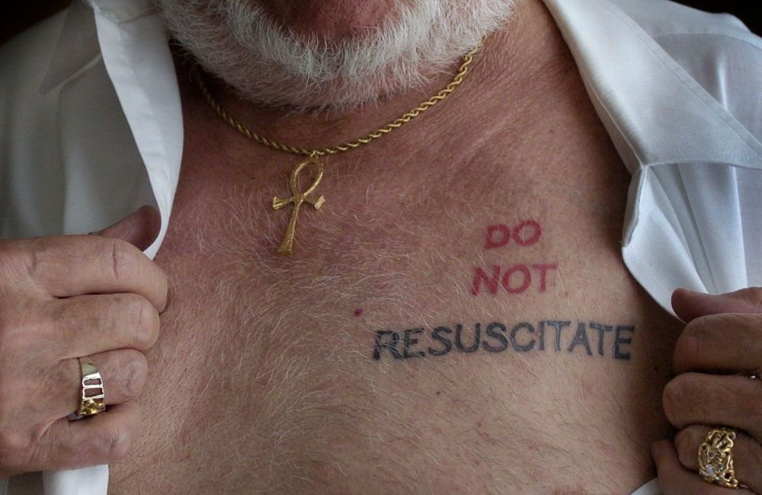
Legal and Ethical Dilemma
Legal and Ethical Dilemma
  Patient arrived at the Emergency Department (ED) unconscious and intubated with DNR tattoo with his signature on his anterior chest.
  The health care team in the ED must assume that the patient wants everything done because there is no health care proxy present, and the patient is unconscious.
  “An ethical dilemma occurs when a person is forced to choose between two or more alternatives, none of which is ideal” (Finkelman, 2019, p. 172).
Stakeholders:
  Nurses and Doctors
  The stakeholders in this ethical dilemma must decide whether or not to do everything possible to save the patient’s life or assume that he wants to be a Do Not Resuscitate (DNR) due to no health care proxy being present.
Addressing the Issue:
  The nurse should address the issue thinking about all legalities.
  A tattoo is not a legal document, therefor all actions should be taken to save the patient’s life until a health care
  Proxy is present or the patient possibly becomes conscious and can make his own medical decisions.
Notes:
When dealing with ethical dilemmas, it is important to keep in mind all of the information you've been given. This particular patient came into the emergency department unconscious with a DNR tattoo on his chest. However, a tattoo is not a legal document and there was no one present to be a health care proxy for this patient. This forced the health care team, which are the stakeholders, to do every thing they could to save this man's life, even if it might be against his wishes.
This is an ethical dilemma and legal dilemma because if the nurse does not follow legal protocols, then there may be legal ramifications if something were to happen to the patient and him not actually be a DNR.

Slide 14
References
Albuterol Oral Inhalation: MedlinePlus Drug Information. (2019, October). Medlineplus.gov. https://medlineplus.gov/druginfo/meds/a682145.html
Finkelman, A. (2019). Professional Nursing Concepts: Competencies for Quality Leadership (4th ed.). Burlington, MA: Jones & Bartlett Learning.
Martin, P. B. (2019, May 31). 6 Mechanical Ventilation Nursing Care Plans. Nurseslabs. https://nurseslabs.com/6-mechanical-ventilation-nursing-care-plans/
Martin, P. B. (2020, December 5). 4 Diabetic Ketoacidosis and Hyperglycemic Hyperosmolar Nonketotic Syndrome Nursing Care Plans. Nurseslabs. https://nurseslabs.com/diabetic-ketoacidosis-nursing-care-plans/
Urden, L. D., Stacy, K. M. & Lough, M. E. (2020). Priorities in Critical Care Nursing (8th ed.). St. Louis, Missouri: Elsevier.

